Slide 1
ECON 151: ELEMENTS OF ECONOMICS I
Lecturer: Paul Owusu Takyi (Ph.D.)
Email: potakyi2005@gmail.com

Slide 2
COURSE OUTLINE
1. Introducing Economics
2. Supply and Demand
3. Government Intervention in the Market
4. Background to demand
5. Background to Supply
6. Profit Maximisation under Perfect
Competition
7. Profit Maximisation under and Monopoly
8. The Theory of Distribution of Income
Text Book: J. Slowman (2006). Economics, 6th Edition

Slide 3


Introducing Economics

Slide 4
Introducing Economics
What do Economists Study?

Slide 5
You may never have studied economics before, and yet when you open a newspaper what do you read? – a report from ‘our economics correspondent’.
Turn on the television news and what do you see? – an item on the state of the economy.
Talk to friends and often the topic will turn to the price of this or that product, or whether you have enough money to afford to do this or that.
We are also continually faced with economic problems and decisions of our own.
What should I buy in the supermarket? Should I save up for a summer holiday, or spend more on day-to-day living? Should I go to university, or should I try to find a job now?

Slide 6
WHAT IS ECONOMICS?
Economics is defined as a science that studies how society uses limited resources, which have alternative uses in an attempt to satisfy unlimited human wants.
Human Wants: Are the things, goods, services and circumstances that people desire
Scarcity: the central economic problem (Limited resources)
  defining scarcity: the excess of human wants over what can actually be produced to fulfil these wants. (limited in supply)
  Choice: Choice refers to the act of making economic decision or selecting from alternatives.
Notes:
2

Slide 7
WHAT IS ECONOMICS?
  Scale of Preference: A scale of preference is an arrangement of wants in order of importance or priority.
  Opportunity Cost: The next best alternative forgone.
  Example
  You have 100 cedis to get the following:
  1. Pizza
  2. Phone
  3. Shoe
  4. Go to Disco.
  If arranged in order of priority by an individual, then the opportunity cost of buying Pizza is the Phone forgone.
Notes:
2

Slide 8
WHAT DO ECONOMISTS STUDY?
  Production, consumption, and distribution
  use of resources (factors of production)
    labour
    land and raw materials
    capital
  demand and supply
    importance of reconciling demand and supply
    actual and potential demand and supply
Notes:
2

Slide 9
WHAT DO ECONOMISTS STUDY?
Macroeconomic issues/goals: is concerned with the economy as a whole.
  growth
  unemployment
  inflation
  balance of payments problems
  cyclical fluctuations
Notes:
3

Slide 10
WHAT DO ECONOMISTS STUDY?
Microeconomic issues
  choices: what, how and for whom
  the concept of opportunity cost: The opportunity cost of working overtime is the leisure you have sacrificed.
  rational economic decision making: involves making a decision that gives you the best value for money
    marginal costs and marginal benefits-how do you make a rational decision about when the alarm should go off?
    MC < MB → do more
    MC > MB → do less
  microeconomic objectives
    Efficiency- 3 conditions of efficiency (production, consumption and specialization and exchange)
    equity
Notes:
3

Slide 11
Question
Assume that you are looking for a job and are offered two. One is more pleasant to do, but pays less. How would you make a rational choice between the two jobs?

Slide 12
WHAT DO ECONOMISTS STUDY?
The production possibility curve/frontier
  The curve shows all combinations of commodities that the economy is capable of producing, using available resources and the most efficient techniques of production
Notes:
4

Slide 13

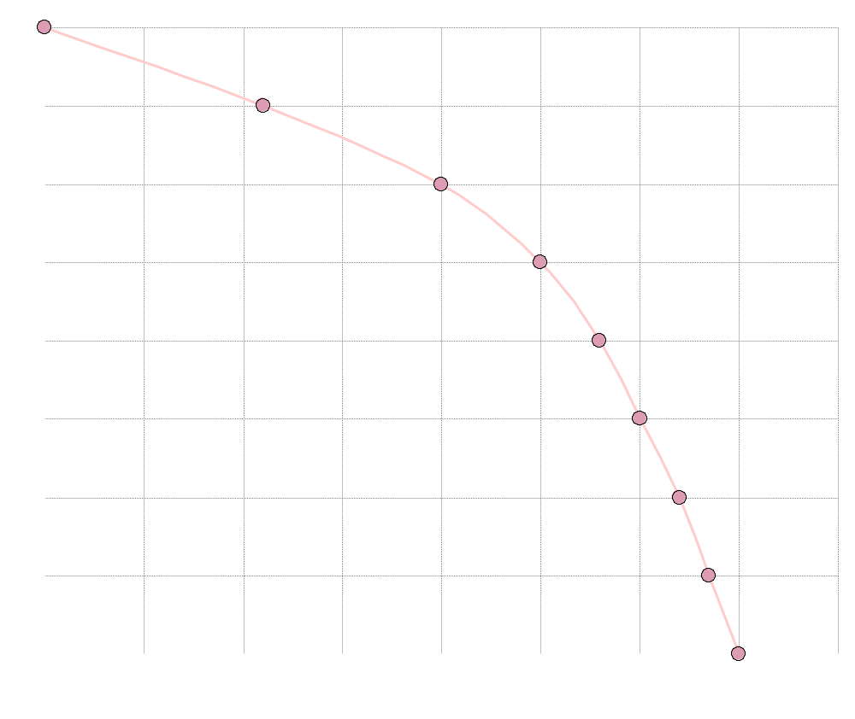

A production possibility curve
Units of food Units of clothing
(millions) (millions)
8m 0.0
7m 2.2m
6m 4.0m
5m 5.0m
4m 5.6m
3m 6.0m
2m 6.4m
1m 6.7m
0 7.0m
Units of food (millions)
Units of clothing (millions)

Slide 14
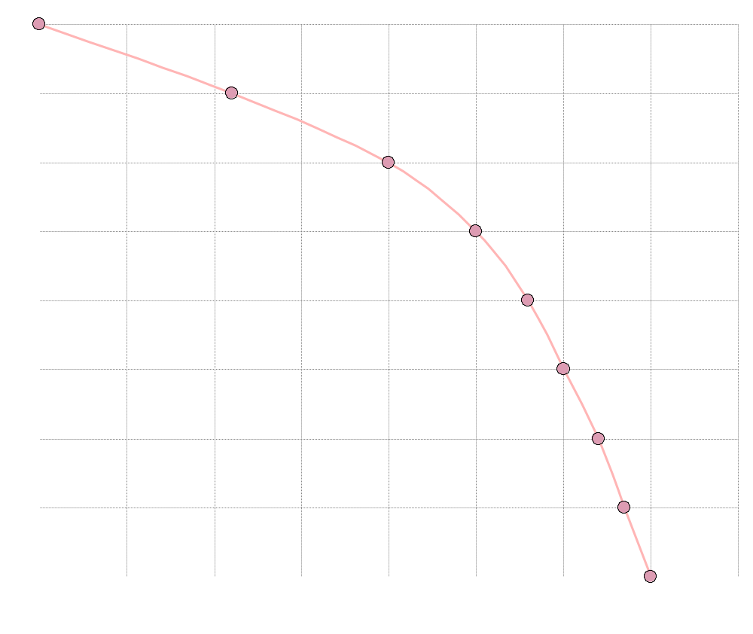
A production possibility curve
a
Units of food Units of clothing
(millions) (millions)
a 8m 0.0
7m 2.2m
6m 4.0m
5m 5.0m
4m 5.6m
3m 6.0m
2m 6.4m
1m 6.7m
0 7.0m
Units of food (millions)
Units of clothing (millions)

Slide 15
A production possibility curve
b
Units of food Units of clothing
(millions) (millions)
8m 0.0
b 7m 2.2m
6m 4.0m
5m 5.0m
4m 5.6m
3m 6.0m
2m 6.4m
1m 6.7m
0 7.0m
Units of food (millions)
Units of clothing (millions)

Slide 16
A production possibility curve
c
Units of food Units of clothing
(millions) (millions)
8m 0.0
7m 2.2m
c 6m 4.0m
5m 5.0m
4m 5.6m
3m 6.0m
2m 6.4m
1m 6.7m
0 7.0m
Units of food (millions)
Units of clothing (millions)

Slide 17
A production possibility curve
Units of food Units of clothing
(millions) (millions)
8m 0.0
7m 2.2m
6m 4.0m
5m 5.0m
4m 5.6m
3m 6.0m
2m 6.4m
1m 6.7m
0 7.0m
Units of food (millions)
Units of clothing (millions)

Slide 18

A production possibility curve
Units of food (millions)
Units of clothing (millions)

Slide 19
A production possibility curve
w
x
Units of food (millions)
Units of clothing (millions)

Slide 20
WHAT DO ECONOMISTS STUDY?
The production possibility curve
  what the curve shows
  microeconomics and the production possibility curve:
Notes:
4

Slide 21
WHAT DO ECONOMISTS STUDY?
The production possibility curve
  what the curve shows
  microeconomics and the production possibility curve:
    choices and opportunity cost
Notes:
4

Slide 22
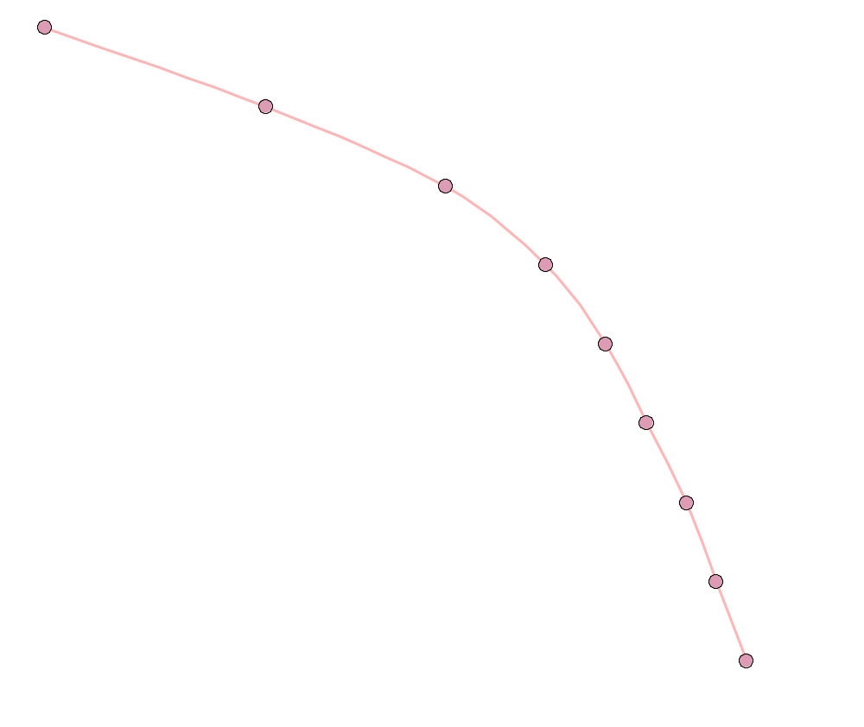
Opportunity cost
x
1
y
1
Units of food (millions)
Units of clothing (millions)

Slide 23
WHAT DO ECONOMISTS STUDY?
The production possibility curve
  what the curve shows
  microeconomics and the production possibility curve:
    choices and opportunity cost
    increasing opportunity cost (The reason for this is that different factors of production have different properties)
Notes:
4

Slide 24
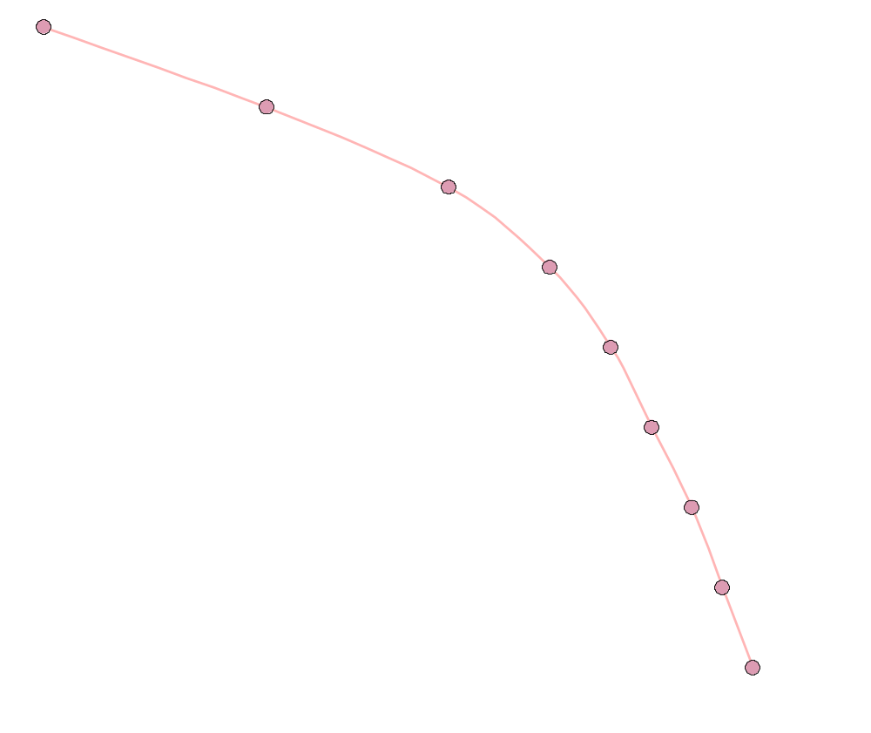
Increasing opportunity costs
x
1
y
1
Units of food (millions)
2
z
1
Units of clothing (millions)

Slide 25
Assignment
Under what circumstances would the production possibility curve be
a straight line;
bowed in towards the origin? Are these circumstances ever likely?

Slide 26
WHAT DO ECONOMISTS STUDY?
The production possibility curve
  what the curve shows
  microeconomics and the production possibility curve:
    choices and opportunity cost
    increasing opportunity cost
  macroeconomics and the production possibility curve:
Notes:
4

Slide 27
WHAT DO ECONOMISTS STUDY?
The production possibility curve
  what the curve shows
  microeconomics and the production possibility curve:
    choices and opportunity cost
    increasing opportunity cost
  macroeconomics and the production possibility curve:
    production within the curve
Notes:
4

Slide 28

Making a fuller use of resources
x
Production inside
the production
possibility curve
y
Food
v
O
Clothing

Slide 29
WHAT DO ECONOMISTS STUDY?
The production possibility curve
  what the curve shows
  microeconomics and the production possibility curve:
    choices and opportunity cost
    increasing opportunity cost
  macroeconomics and the production possibility curve:
    production within the curve (Inefficient); Outside the curve (Unattainable)
    shifts in the curve
Notes:
4

Slide 30

Growth in potential output
Food
Now
O
Clothing

Slide 31
Growth in potential output
5 years’ time
Food
Now
O
Clothing

Slide 32
Growth in potential and actual output
Food
O
Clothing

Slide 33
Growth in potential and actual output
y
x
Food
O
Clothing

Slide 34
WHAT DO ECONOMISTS STUDY?
The circular flow of income
  firms and households
Notes:
5

Slide 35
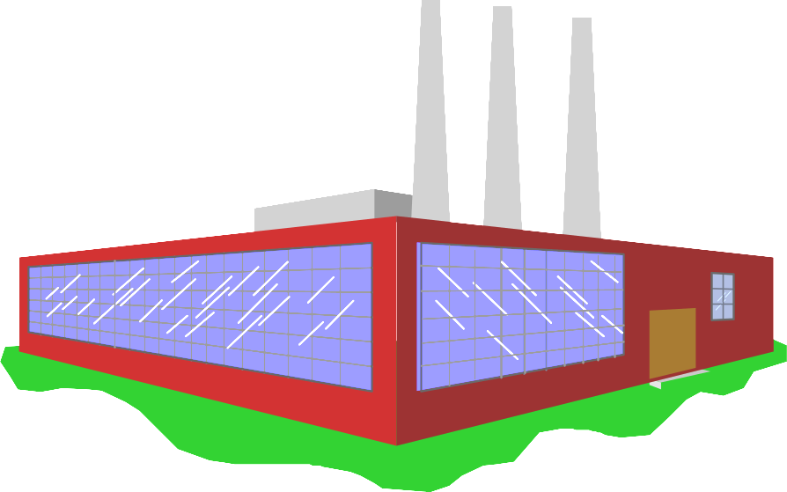

The circular flow of goods and incomes

Slide 36
WHAT DO ECONOMISTS STUDY?
The circular flow of income
  firms and households
  real and money flows
Notes:
5

Slide 37
The circular flow of goods and incomes

Slide 38
The circular flow of goods and incomes
Goods and services

Slide 39
The circular flow of goods and incomes
Goods and services
£
Consumer
expenditure

Slide 40
The circular flow of goods and incomes
Goods and services
£
Consumer
expenditure
Services of factors of production (labour, etc)

Slide 41
The circular flow of goods and incomes
Goods and services
£
Consumer
expenditure
Wages, rent
dividends, etc.
£
Services of factors of production (labour, etc)

Slide 42
WHAT DO ECONOMISTS STUDY?
The circular flow of income
  firms and households
  real and money flows
  goods and factor markets
Notes:
5

Slide 43
The circular flow of goods and incomes
Goods and services
£
Consumer
expenditure
GOODS MARKETS
FACTOR MARKETS
Wages, rent
dividends, etc.
£
Services of factors of production (labour, etc)

Slide 44
WHAT DO ECONOMISTS STUDY?
The circular flow of income
  firms and households
  real and money flows
  goods and factor markets
  macroeconomics: the total flows
Notes:
5

Slide 45
The circular flow of goods and incomes
Goods and services
£
Consumer
expenditure
GOODS MARKETS
FACTOR MARKETS
Wages, rent
dividends, etc.
£
Services of factors of production (labour, etc)

Slide 46
WHAT DO ECONOMISTS STUDY?
The circular flow of income
  firms and households
  real and money flows
  goods and factor markets
  macroeconomics: the total flows
  microeconomics: individual markets
Notes:
5

Slide 47
The circular flow of goods and incomes
Goods and services
£
Consumer
expenditure
GOODS MARKETS
FACTOR MARKETS
Wages, rent
dividends, etc.
£
Services of factors of production (labour, etc)

Slide 48
Introducing Economics
Economic Systems

Slide 49
ECONOMIC SYSTEMS
Classifying economic systems
  methods of classification
  classification by degree of government control
Notes:
6

Slide 50

Classifying economic systems
Totally
planned
economy
Totally
free-market
economy

Slide 51
Classifying economic systems
Mid 1980s
N. Korea
China
UK
Hong
Kong
Cuba
Poland
France
USA
Totally
planned
economy
Totally
free-market
economy

Slide 52
Classifying economic systems
Mid 1980s
N. Korea
China
UK
Hong
Kong
Cuba
Poland
France
USA
Totally
planned
economy
Totally
free-market
economy
N. Korea
Cuba
China
Poland
France
USA
UK
China
(Hong
Kong)
Mid 2000s

Slide 53
ECONOMIC SYSTEMS
Classifying economic systems
  methods of classification
  classification by degree of government control
  other methods of classification
Notes:
6

Slide 54
ECONOMIC SYSTEMS
Classifying economic systems
  methods of classification
  classification by degree of government control
  other methods of classification
The command economy
Notes:
6

Slide 55
ECONOMIC SYSTEMS
Classifying economic systems
  methods of classification
  classification by degree of government control
  other methods of classification
The command economy
  features of a command economy
Notes:
6

Slide 56
ECONOMIC SYSTEMS
Classifying economic systems
  methods of classification
  classification by degree of government control
  other methods of classification
The command economy
  features of a command economy
  planning:
Notes:
6

Slide 57
ECONOMIC SYSTEMS
Classifying economic systems
  methods of classification
  classification by degree of government control
  other methods of classification
The command economy
  features of a command economy
  planning:
    It plans the allocation of resources between current consumption and investment for the future.
Notes:
6

Slide 58
ECONOMIC SYSTEMS
Classifying economic systems
  methods of classification
  classification by degree of government control
  other methods of classification
The command economy
  features of a command economy
  planning:
    consumption and investment
    matching of inputs and outputs
Notes:
6

Slide 59
ECONOMIC SYSTEMS
Classifying economic systems
  methods of classification
  classification by degree of government control
  other methods of classification
The command economy
  features of a command economy
  planning:
    consumption and investment
    matching of inputs and outputs
    distribution of output
Notes:
6

Slide 60
ECONOMIC SYSTEMS
Advantages of a command economy
  high investment, high growth
  stable growth
  social goals pursued
  low unemployment
Problems of a command economy
  problems of gathering information
  expensive to administer
  inappropriate incentives
  shortages and surpluses
Notes:
8

Slide 61
ECONOMIC SYSTEMS
The free-market economy
  demand and supply decisions
  the price mechanism:
    shortages and surpluses
    equilibrium price
    response to changes in demand and supply
Notes:
9

Slide 62
ECONOMIC SYSTEMS
The free-market economy
  demand and supply decisions
  the price mechanism:
    shortages and surpluses
    equilibrium price
    response to changes in demand and supply
  the interdependence of markets
Notes:
9

Slide 63
ECONOMIC SYSTEMS
Advantages of a free-market economy
  transmits information between buyers and sellers
  no need for costly bureaucracy
  incentives to be efficient
  competitive markets responsive to consumers
Notes:
9

Slide 64
ECONOMIC SYSTEMS
Problems of a free-market economy
  competition may be limited: problem of market power
  inequality
  the environment and other social goals may be ignored
The mixed economy
Notes:
9

Slide 65
Introducing Economics
The Nature of Economic Reasoning

Slide 66
THE NATURE OF ECONOMIC REASONING
Economics as a science (predict and explain)
  models in economics ( part or whole economy)
  building models (hypotheses to explain causes of economic situation-induction)
  using models (explain and predict)
  assessing models (accurate predictions)
Economics as a social science
  difficulties in conducting controlled experiments in many parts of the subject
  problems of predicting human behaviour
Notes:
12

Slide 67
THE NATURE OF ECONOMIC REASONING
Positive Economics: Economics is neutral to social goals and indicates the consequences of actions. Example: If commercials banks reduce interest rate on their loans, firms will borrow more to expand their operation
Normative Economics: Study of the way that economic relationships ought to be. Value judgments play an integral part in the ranking and choosing of possible objectives. Example: The commercial banks should cut their lending rates
Notes:
12

